Slide 2
Recap
Financial statement analysis
It is the process of identifying strengths and weaknesses →between BS and P &L a/c.
Can be under taken by the management or by the parties outside the firm
Trade creditors: short period→ liquidity position
Suppliers of long-term debt→ long-term solvency and survival
Investors: steady growth in earning → profitability
Management: every aspect

Slide 3
Nature of Ratio Analysis
Ratio: “Quotient of two mathematical expression” and as “the relationship between two or more things”
Used as a benchmark for evaluating the financial position and performance of a firm
An accounting figure conveys meaning when it is related to some other relevant information.
Can be expressed as a fraction, proportion, percentage and a number of times
Helps to summarize large quantities of financial data and to make qualitative judgment about financial performance.
Standards of Comparison
(i) Past ratio (ii) Competitor's ratio (iii) Industry ratio (iv) Projected ratio

Slide 4
Objectives
To know the areas of the business which need more attention;
To know about the potential areas which can be improved
Deeper analysis of the profitability, liquidity, solvency and efficiency levels
For cross-sectional analysis
For projections and estimates for the future.

Slide 5
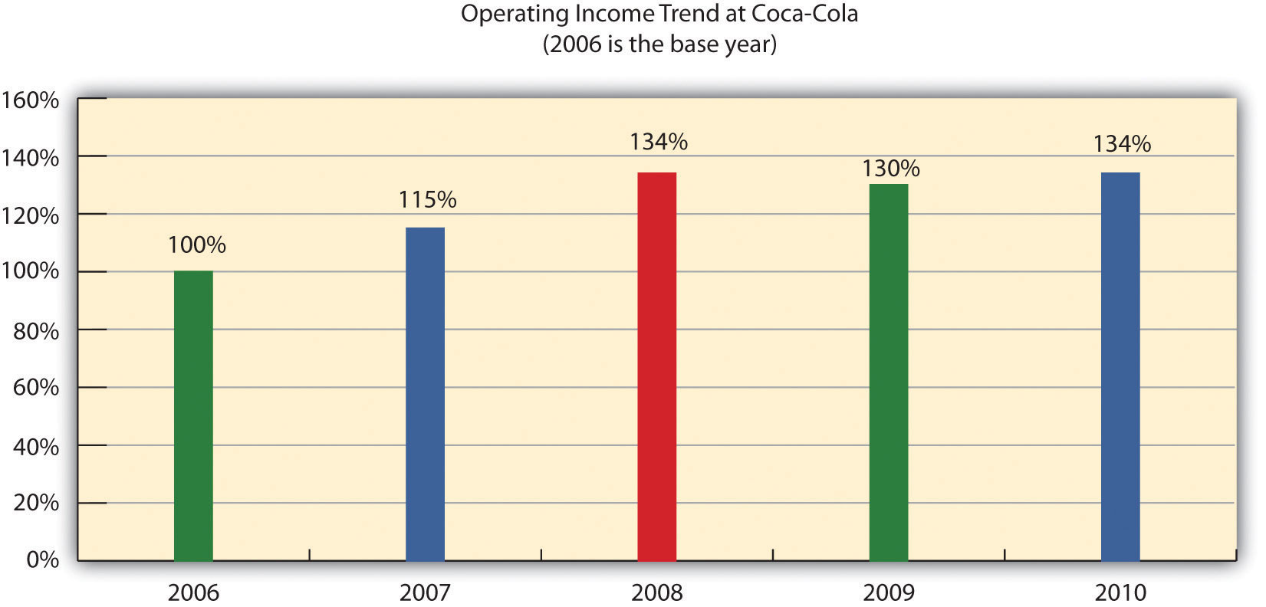

Slide 6
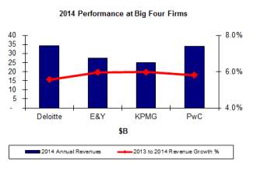

Slide 7
Types of Ratios
Liquidity ratios
Leverage ratios
Activity ratios
Profitability ratios

Slide 8
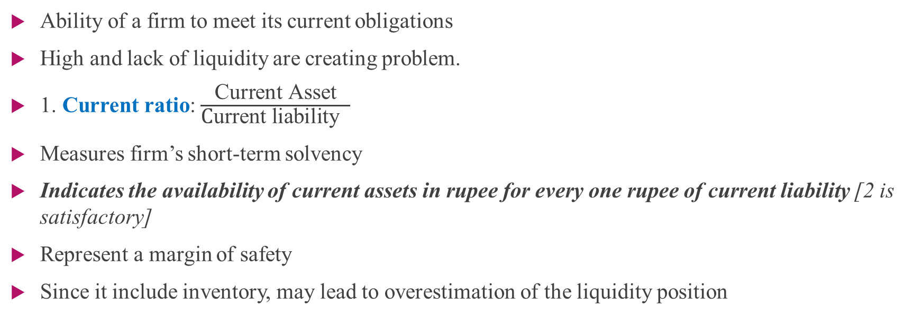
Liquidity ratio
Ability of a firm to meet its current obligations
High and lack of liquidity are creating problem.
1. Current ratio: $\frac{\text{Current} \text{Asset}}{\text{C}\text{urrent} \text{liability} }$
Measures firm’s short-term solvency
Indicates the availability of current assets in rupee for every one rupee of current liability [2 is satisfactory]
Represent a margin of safety
Since it include inventory, may lead to overestimation of the liquidity position

Slide 9
Current investments,
Inventories,
Trade receivables (debtors and bills receivables)
Cash and cash equivalents,
Short-term loans and advances
Other current assets such as prepaid expenses, advance tax and accrued income

Slide 10
Cash = $15 million
Marketable securities = $20 million
Inventory = $25 million
Short-term debt = $15 million
Accounts payables = $15 million
Current assets = 15 + 20 + 25 = 60 million
Current liabilities = 15 + 15 = 30 million
Current ratio = 60 million / 30 million = 2.0

Slide 11
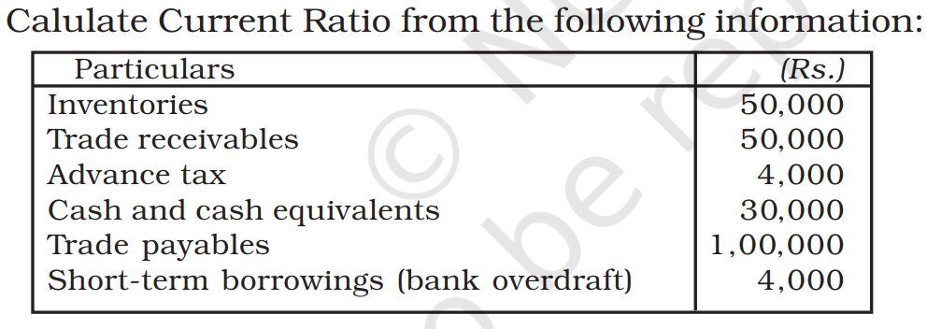

Slide 12
Interpreting current ratio
A ‘good’ or ‘bad’ ratio depends on how it is changing
 | 2017 | 2018 | 2019 | 2020 | 2021 | 2022
Sara’s co | .73 | .82 | .93 | .95 | .97 | 1.00
Mews ltd | 1.25 | 1.14 | 1.35 | 1.26 | 1.15 | 1.00

Slide 13
2. Quick Ratio ( Acid-test ratio) :
Indicator of a companies short-term liquidity position and measures its ability to meet the short term obligations using the most liquid assets
Ratio of liquid asset to current liability.
( cash, debtors, money market instruments, marketable securities)
Exclude inventories, prepaid expenses, and advance tax
Commercial paper, CD
[ 1: 1 is a good measure]

Slide 15

3. Cash Ratio ( expressed in percentage)
CR= $\frac{Cash+Marketable Securities }{Current Libilities}$

Slide 16
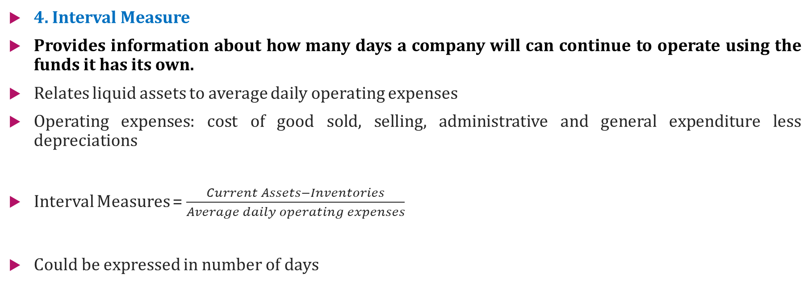
4. Interval Measure
Provides information about how many days a company will can continue to operate using the funds it has its own.
Relates liquid assets to average daily operating expenses
Operating expenses: cost of good sold, selling, administrative and general expenditure less depreciations
Interval Measures = $\frac{Current Assets−Inventories}{Average daily operating expenses}$
Could be expressed in number of days

Slide 17
Leverage Ratios
L R Shows firms ‘long terms debt-paying ability’
Long term investors are more concerned with long term financial position.
These ratios indicate mix of funds provided by owners and lenders.
Between debt and equity
The process of magnifying the share holders return through the use of debt is called financial leverage.

Slide 18
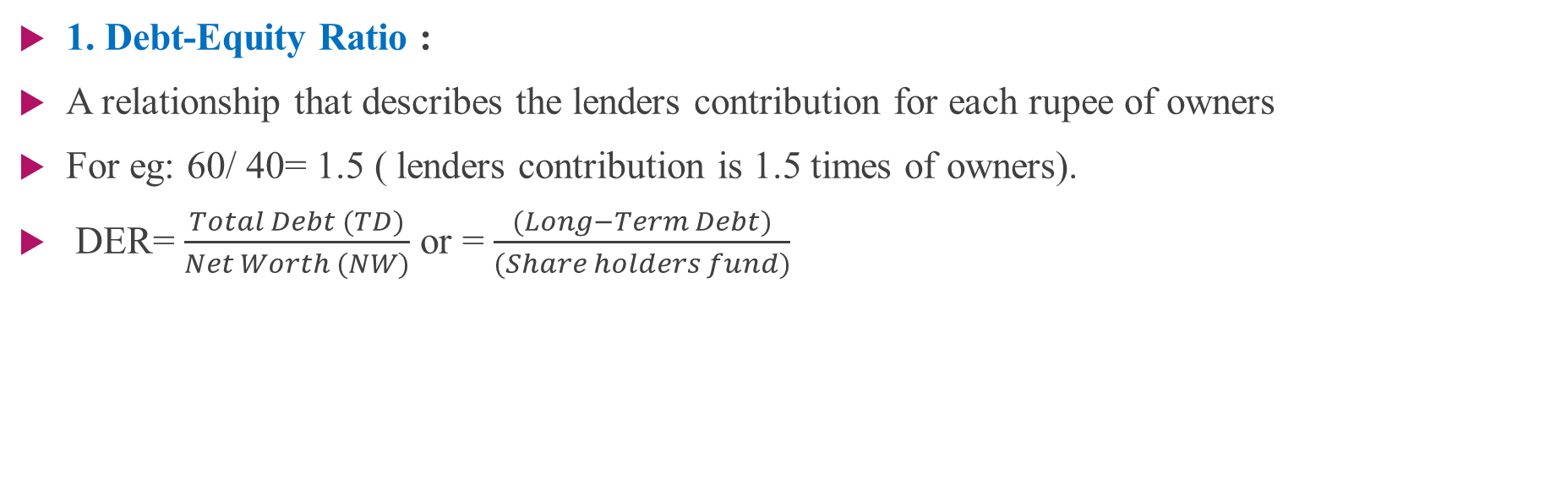
1. Debt-Equity Ratio :
A relationship that describes the lenders contribution for each rupee of owners
For eg: 60/ 40= 1.5 ( lenders contribution is 1.5 times of owners).
DER= $\frac{Total Debt (TD)}{Net Worth (NW)}$ or = $\frac{(Long−Term Debt)}{(Share holders fund)}$

Slide 19
Shareholders fund= Share capital + Reserves and Surpluses+ Money Received against share Warrant+ share application money pending allotment
Net Worth = Non-Current asset + Working Capital- Non-Current Liability
High debt ratio (higher claim of creditors) leads to debt trap
Lower debt ratio ( higher claim of owners)

Slide 20
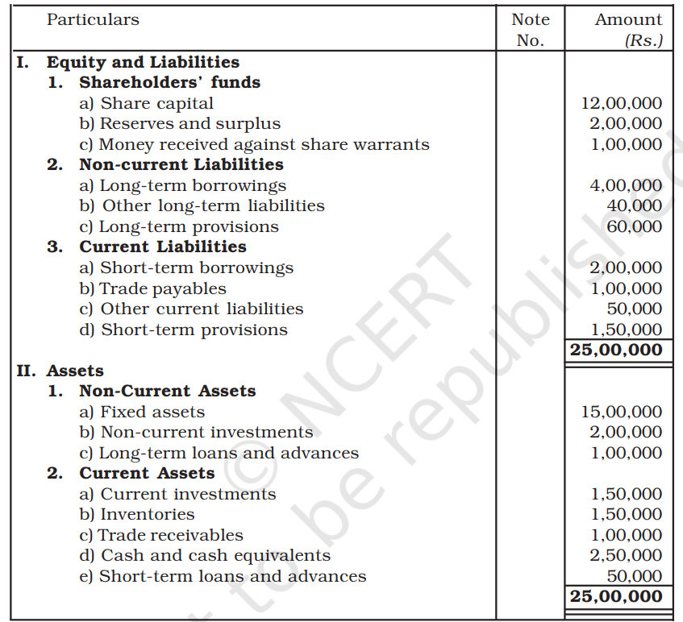

Slide 21
2. Proprietary Ratio Expresses relationship of proprietor’s (shareholders) funds to net assets
Proprietary Ratio = Shareholders’ Funds/Capital employed (or net assets)
Higher proportion of shareholders funds in financing the assets is a positive feature as it provides security to creditors.

Slide 22
3. Total Assets to Debt Ratio
This ratio measures the extent of the coverage of long-term debts by assets.
Total assets to Debt Ratio = Total assets/Long-term debts
The higher ratio indicates that assets have been mainly financed by owners funds and the long-term loans is adequately covered by assets.
This ratio primarily indicates the rate of external funds in financing the assets and the extent of coverage of their debts are covered by assets.

Slide 23
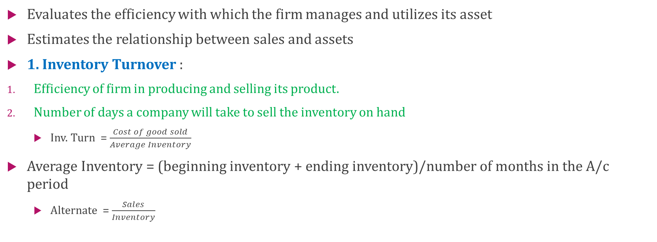
Activity Ratios (Turnover ratio)
Evaluates the efficiency with which the firm manages and utilizes its asset
Estimates the relationship between sales and assets
1. Inventory Turnover :
Efficiency of firm in producing and selling its product.
Number of days a company will take to sell the inventory on hand
Inv. Turn = $\frac{Cost of good sold}{Average Inventory}$
Average Inventory = (beginning inventory + ending inventory)/number of months in the A/c period
Alternate = $\frac{Sales}{Inventory}$

Slide 24
Example
Cherry Woods Furniture is a specialized supplier of handmade dining sets made from specialty woods. Over Q3, its busiest period, the retailer posted $48,000 in COGS and $16,000 in average inventory. To find the inventory turnover ratio, we divide $48,000 by $16,000. The inventory turnover is 3.
In the second example, we’ll use the same company and the same scenario as above, but this time compute the average inventory period—meaning how long it will take to sell the inventory currently on hand.
365/3=121.67 days

Slide 25

2. Assets Turnover Ratio: $\frac{Sales}{Net Assets}$ or $\frac{Sales}{Total Assets}$

Slide 26
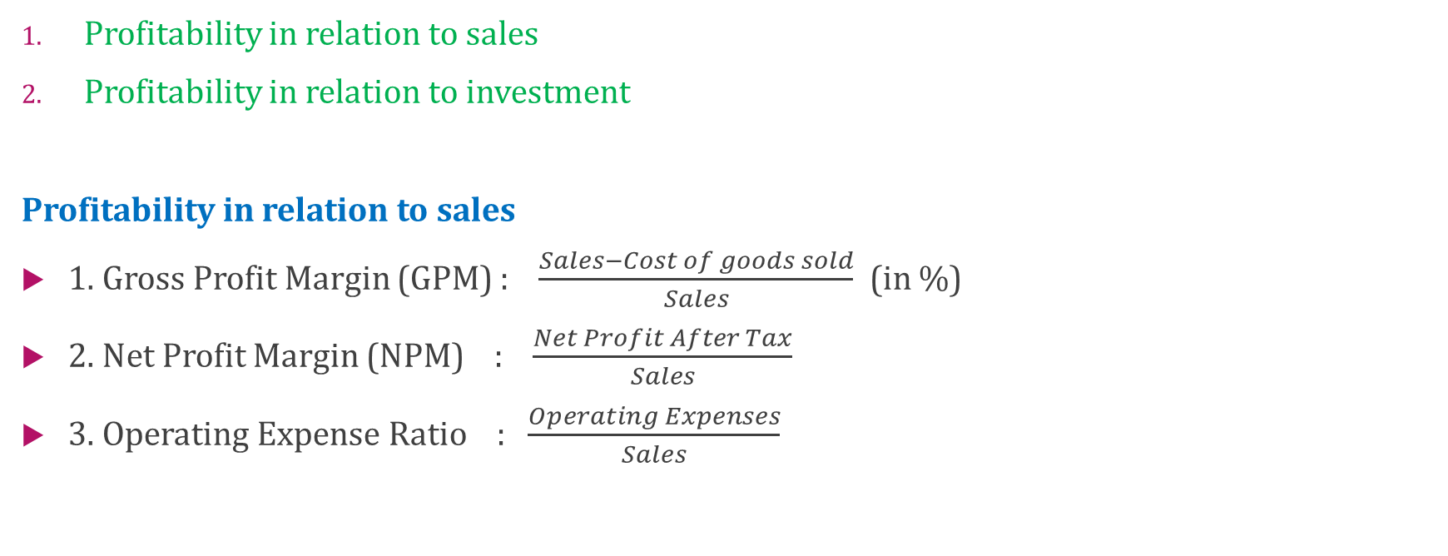
Profitability Ratio
Profitability in relation to sales
Profitability in relation to investment
Profitability in relation to sales
1. Gross Profit Margin (GPM) : $\frac{Sales−Cost of goods sold}{Sales}$ (in %)
2. Net Profit Margin (NPM) : $\frac{Net Profit After Tax}{Sales}$
3. Operating Expense Ratio : $\frac{Operating Expenses}{Sales}$

Slide 27
Return on Investment
Measures the probability of gaining a return from an investment
ROI is calculated by subtracting the initial value of the investment from the final value of the investment (which equals the net return), then dividing this new number (the net return) by the cost of the investment, then finally, multiplying it by 100.
Using net return because it may be positive or negative

Slide 28
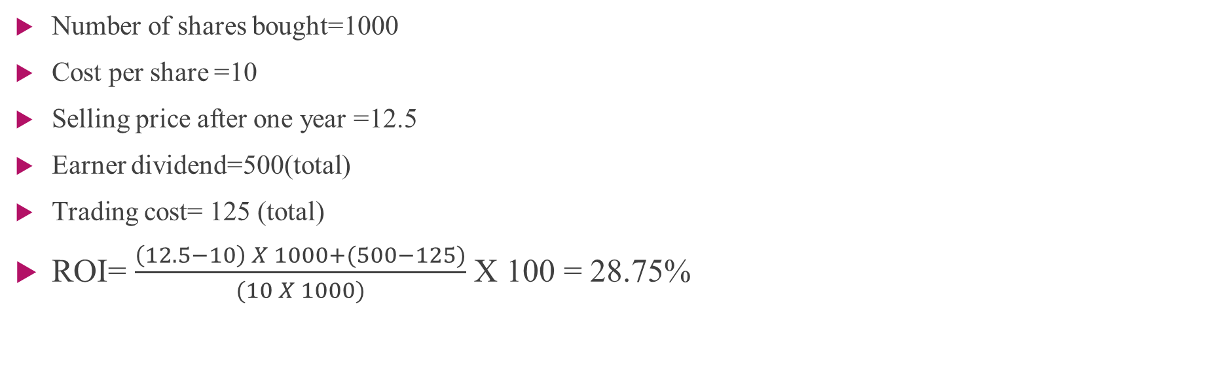
Example
Number of shares bought=1000
Cost per share =10
Selling price after one year =12.5
Earner dividend=500(total)
Trading cost= 125 (total)
ROI= $\frac{\left(12.5−10\right) X 1000+(500−125)}{(10 X 1000)}$ X 100 = 28.75%

Slide 29
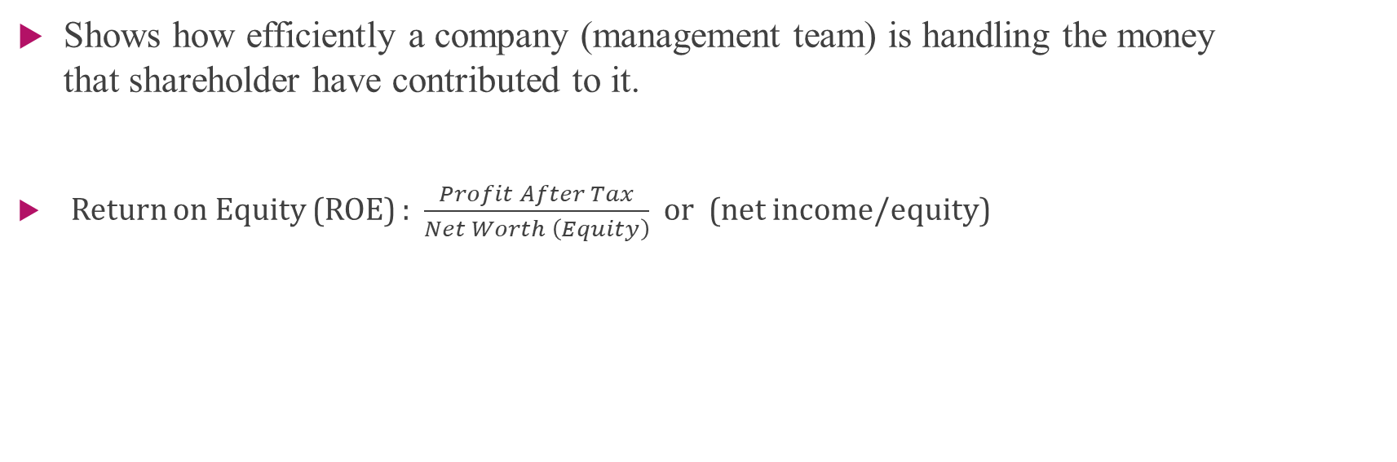
ROE
Shows how efficiently a company (management team) is handling the money that shareholder have contributed to it.
Return on Equity (ROE) : $\frac{Profit After Tax}{Net Worth \left(Equity\right)}$ or (net income/equity)

Slide 30
DuPont analysis
In ROE, we use book value of a company's common equity
A generalized method of calculating the ROE
Used to decompose the different drivers of ROE
The decomposition allows investors to focus on the key matrices of financial performance individually to identity the strength and weaknesses
DuPont Analysis ROE = NPM x Asset Turnover x Equity multiplier
Equity multiplier = Average total assets/ Average shareholders equity
Equity multiplier is a risk indicator

